Slide 1


BREAST CANCER CLASSIFICATION USING MACHINE LEARNING
NADHA FITRI

Slide 2





PROBLEM
Breast cancer is the leading cause of death in women worldwide
Early detection is very important to increase the chances of recovery.
Machine Learning can help diagnose faster and more accurately
the solution ...
Analyzing various algorithms to find the best model
TOOLS & LIBRARY :

Slide 3
CLASSIFICATION ALGORITHM
RANDOM FOREST, LOGISTIC REGRESSION, SVC, KNN
Logistic Regression
SVC (Support Vector Classifier)
Simple model for structured data
Suitable for high-dimensional data
Random Forest
K-Nearest Neighbors (KNN)
High accuracy ensemble model
Nearest neighbor based algorithm

Slide 4
THE PROCESS FOR BREAST CANCER DATA CLASSIFICATION
01
04
Import Data
Training Model
02
05
Load Data
Evaluation and Visualization
03
Preprocessing Data

Slide 5
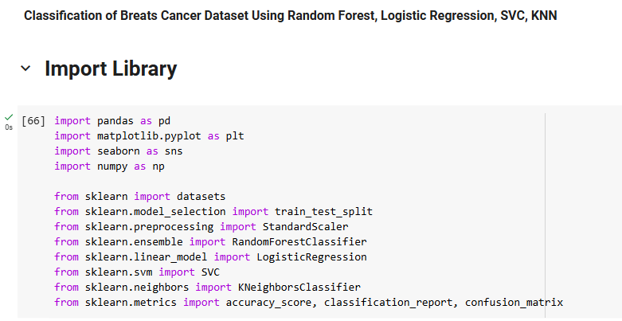
IMPORT LIBRARY

Slide 6
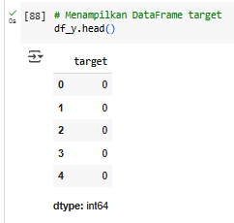
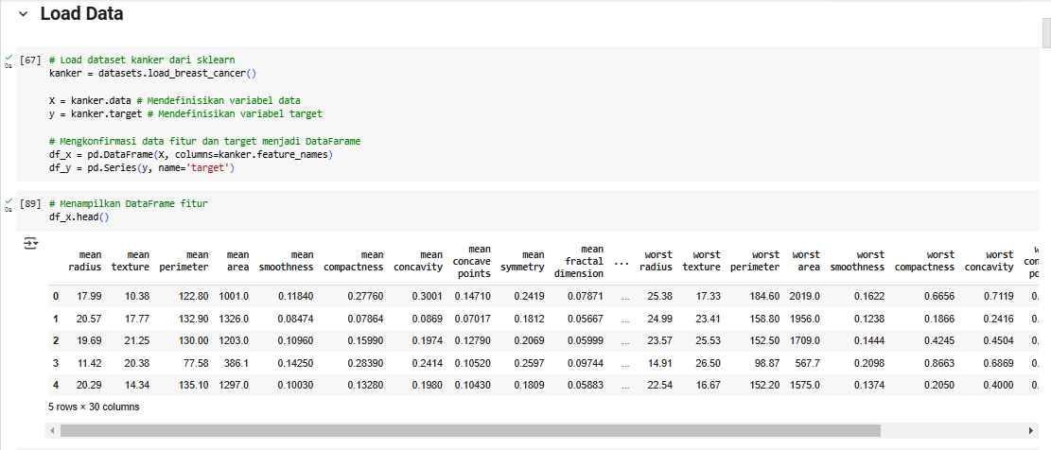
LOAD DATA

Slide 7
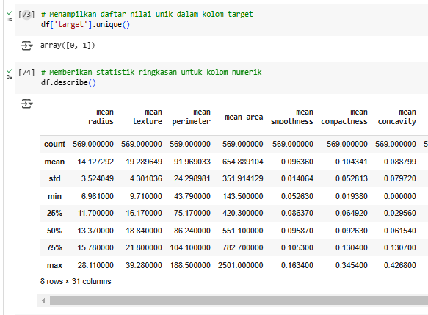
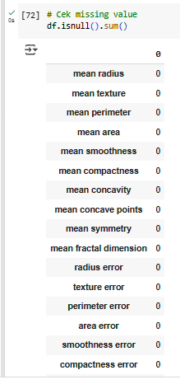
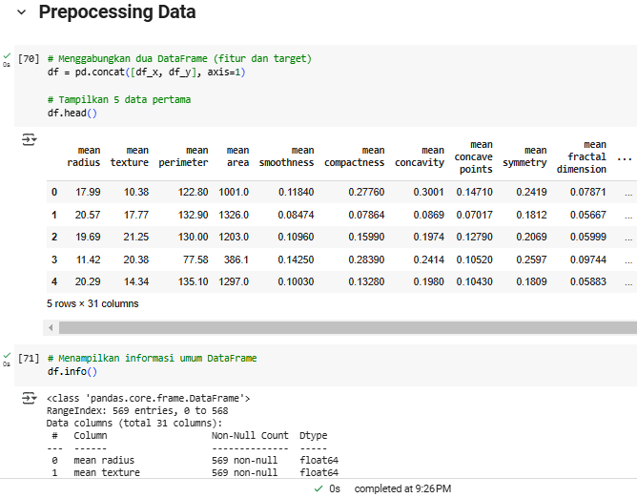
PREPROCESSING DATA
EXPLORATORY DATA ANALYSIS (EDA)

Slide 8
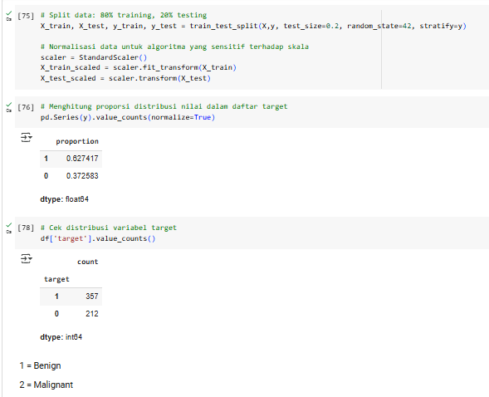
PREPROCESSING DATA

Slide 9
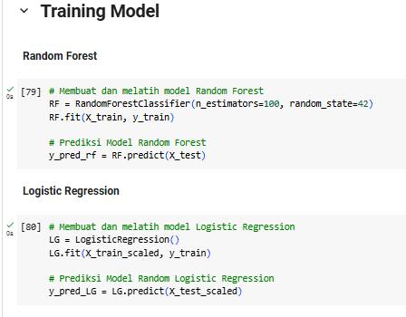
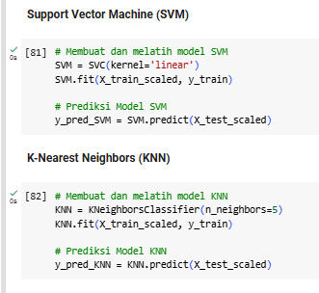
TRAINING MODEL

Slide 10
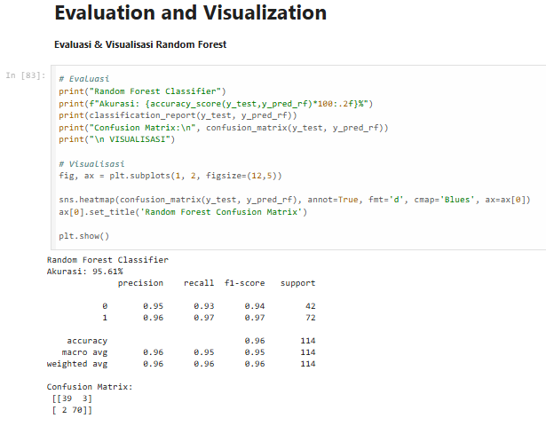
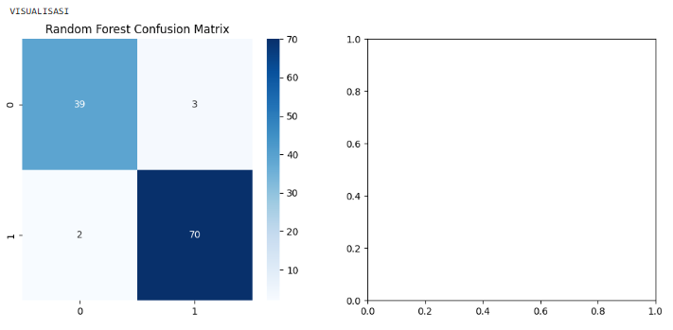
EVALUATION AND VISUALIZATION
RANDOM FOREST

Slide 11
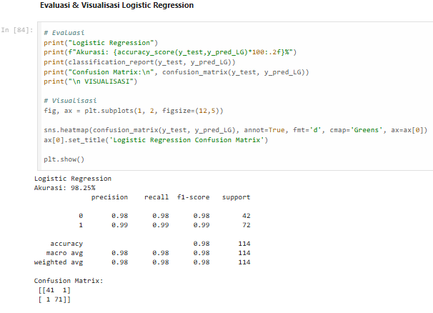
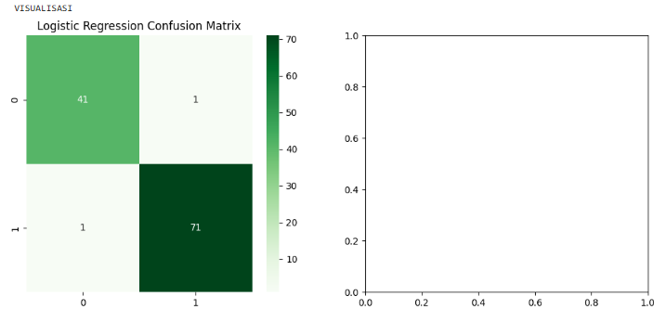
EVALUATION AND VISUALIZATION
LOGISTIC REGRESSION

Slide 12
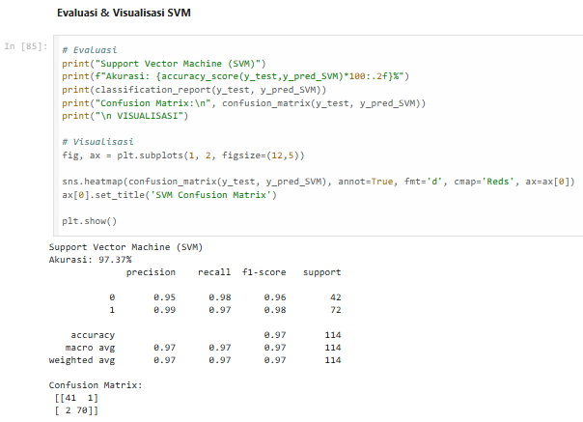
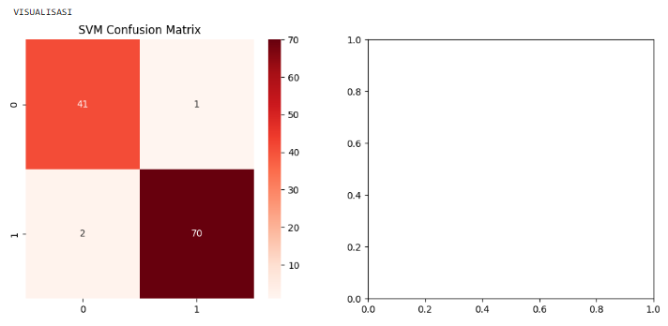
EVALUATION AND VISUALIZATION
SUPPORT VECTOR MACHINE (SVM)

Slide 13
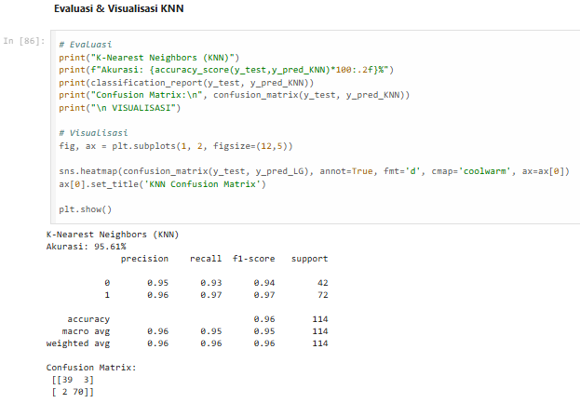
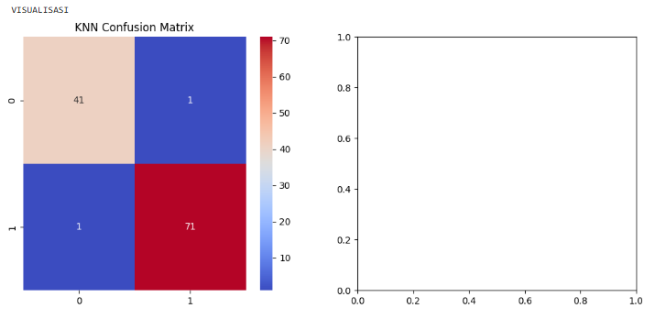
EVALUATION AND VISUALIZATION
K-NEAREST NEIGHBORS (KNN

Slide 14
EVALUATION & CONCLUSION
Confusion Matrix
Evaluation Results
Random Forest has the best results with low FN.
This model is suitable for use in diagnosis because it has minimal errors.
Random Forest, SVC, and KNN have good performance, but are less than optimal.
False Negatives must be minimized to avoid misdiagnosis.
Logistic Regression → Akurasi 98% (Model terbaik)
Random Forest → Akurasi 95%
SVC → Akurasi 97%
KNN → Akurasi 95%
Logistic Regression
*Best Algorithm
Notes:
• Akurasi: Seberapa sering model memprediksi dengan benar
• Precision: Seberapa akurat model dalam memprediksi kanker ganas
• Recall (Sensitivity): Seberapa baik model mendeteksi kanker ganas
• Confusion Matrix: Melihat kesalahan prediksi
Hasil Evaluasi:
• Logistic Regression → Akurasi 98%
• Random Forest → Akurasi 95% (Model terbaik)
• SVC → Akurasi 97%
• KNN → Akurasi 95%
• Random Forest memiliki hasil terbaik dengan FN rendah.
• Model ini cocok digunakan dalam diagnosis karena minim kesalahan.
• Logistic Regression, SVC, dan KNN memiliki performa baik, tetapi kurang optimal.
• False Negative harus diminimalkan untuk menghindari kesalahan diagnosis.
Kesimpulan: Machine Learning dapat membantu dalam diagnosis kanker payudara, dengan Random Forest sebagai model terbaik dalam penelitian ini.

Slide 15
THANK YOU
FOR YOUR NICE ATTENTION
Email
Linkedin
Github
February 2025
nadhaffff@gmail.com
linkedin.com/in/nadhafitri
github.com/nadhafitri17/Breast-Cancer-Classification.git

